Slide 1
Azure Practicals
Practical 7 - Task 1

Slide 2
Azure Practicals Preparation
1. Requirements:
Windows 7 Enterprise
Windows Studio 2010 Professional
Windows Azure Account
Windows Azure SDK (The latest one is 1.4)

Slide 3
Azure Practicals Preparation
2. Install Windows Azure SDK:
http://www.microsoft.com/windowsazure/sdk/
(The latest version is 1.4.)
Tips: Be aware the version you choose. You must choose the correct version.
If your machine is 32 bits → x86
If your machine is 64 bits → x64

Slide 4
Practical 7 - Task 1:
Goal:
Create a Web Service and deploy it on the Windows Azure
Create a client application to call this service.
Prerequisites:
Make sure necessary tools have been installed.
NET programming background, i.e. previous pracs.

Slide 5
Practical 7 - Task 1:
Step 1:
Run Windows Studio 2010 Professional by Administrator.
On the File menu, click New and then click Project. Here we name the project “AzureReturnString”. Click Ok.

Slide 6
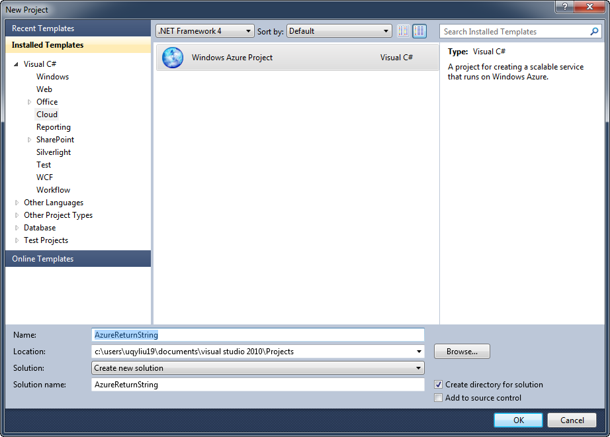
Step 1:
Open the File menu on the top, click New and then click Project

Slide 7
Practical 7 - Task 1:
Step 2:
On the prompt New Windows Azure Project Window, select the WCF Services Web Role and add it to the right side. Then click Ok.

Slide 8
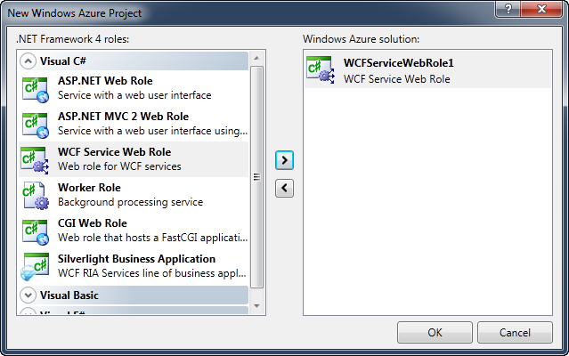
Practical 7 - Task 1:

Slide 9
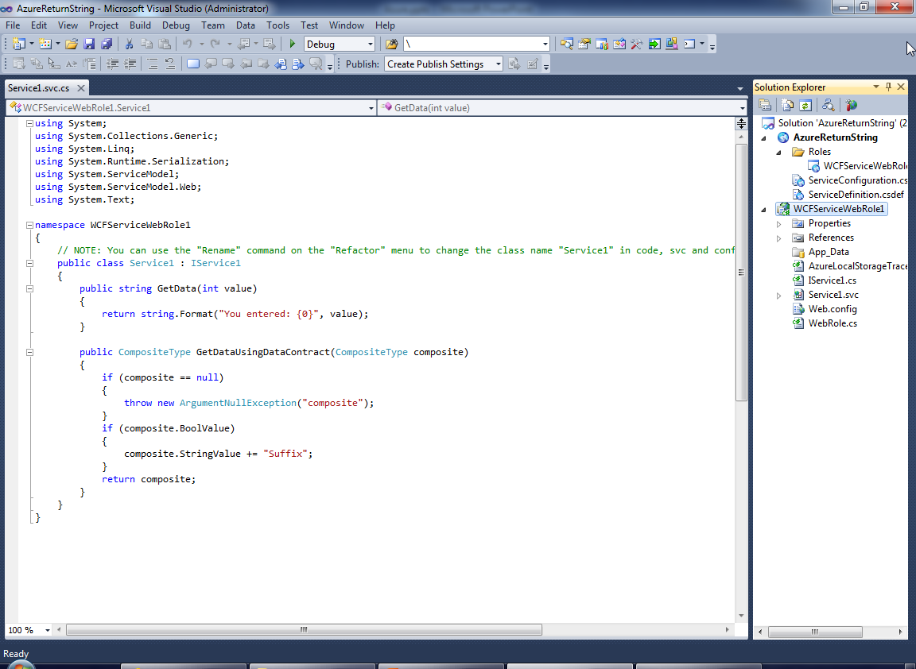
Visual Studio automatically creates a svc.cs file as above.

Slide 10
Practical 7 - Task 1:
Step 3:
Open the Solution Explorer, find and double click the file named IService1.cs. Inside the nameplace WCFServiceWebRole1, modify the interface IService1. add the following code. After that save and close the IService1.cs file.

Slide 11
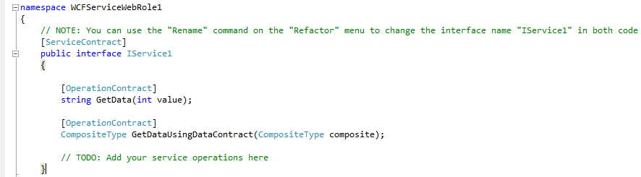
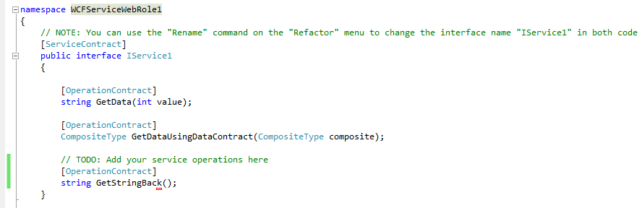
Before modification:
After modification:

Slide 12
Practical 7 - Task 1:
Step 4:
Modify Service1.svc.cs to contain the implementation of the method GetStringBack(). After that, save and close Service1.svc.cs.

Slide 13
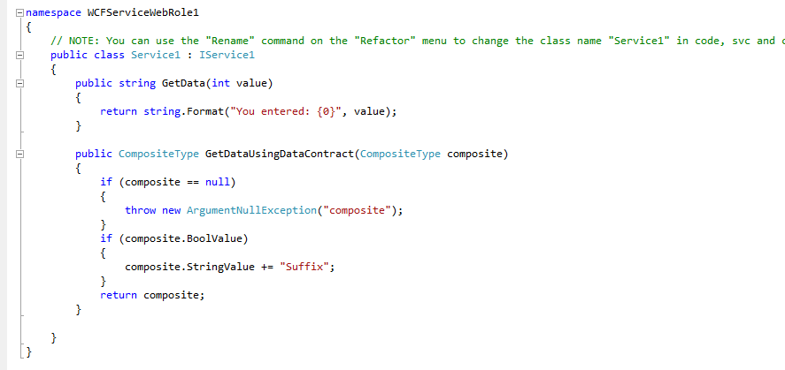
Before modification:

Slide 14
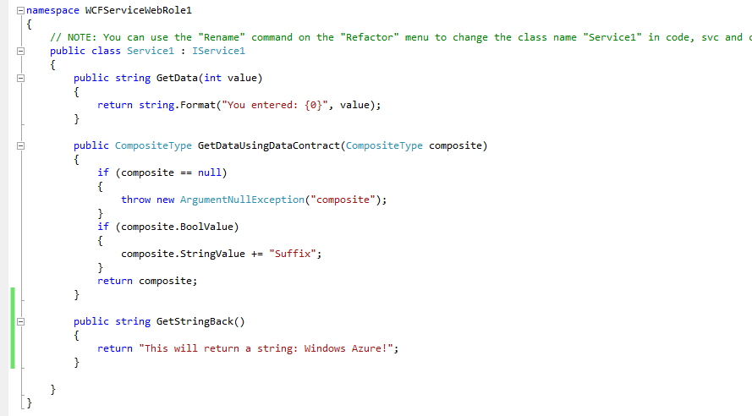
After modification:

Slide 15
Practical 7 - Task 1:
Step 5:
Compile and run the service by clicking Debug from the menu and then clicking Start Without Debugging.
(if there is no errors then this service is successfully created.)

Slide 16
Practical 7 - Task 1:
Step 6:
Deploy this service to the Windows Cloud. To do so, firstly we right click the project name on the solution explorer.
Then log in Windows Azure management portal at http://windows.azure.com.

Slide 17
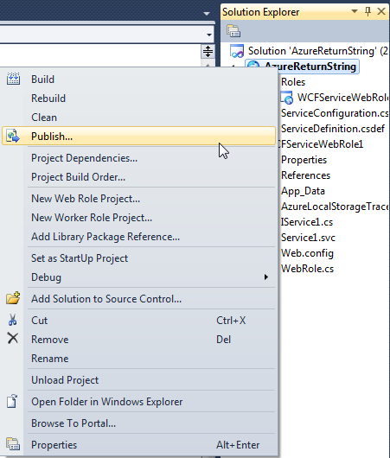

Practical 7 - Task 1:
Click the publish and assume that is successfully compiled, the Windows Visual Studio will prompt a folder with two files inside.
AzureReturnString.cspkg is the package file that contains the service definition as well as the binaries and other items for the application being deployed.

Slide 18
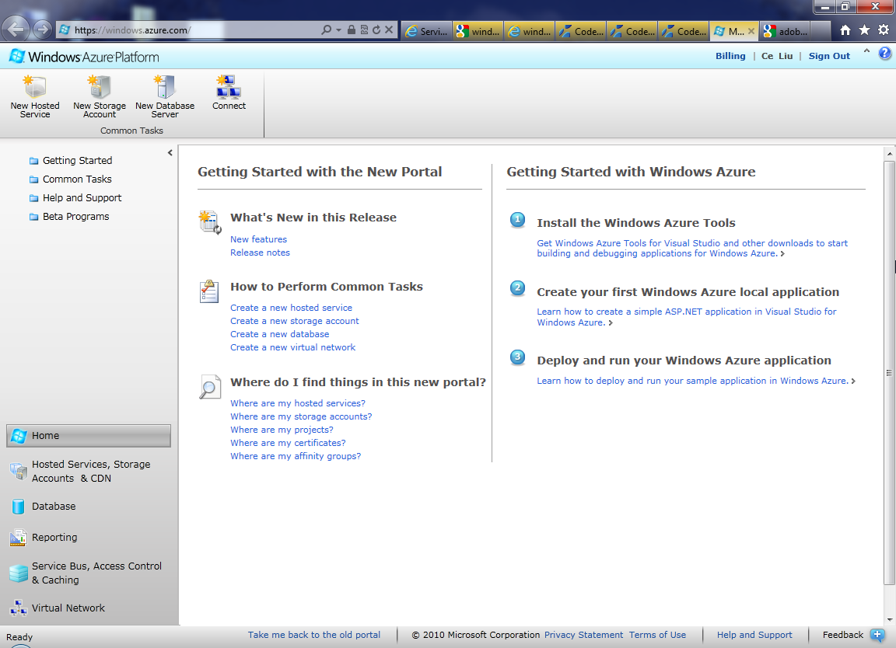
Windows Azure Platform management Web page:

Slide 19
Practical 7 - Task 1:
Step 7:
Within the Windows Azure management portal, click Hosted Services, Storage Accounts & CDN. Then Click New Hosted Service.
Choose a subscription name and then fill the name of the service and url, choose a region from the list of regions. Then choose Deploy to stage environment. Make sure that Start after successful deployment is checked. Specify a name for the deployment.
For Package location, use the file named AzureReturnString.cspkg we created in last step; for Configuration file, use the ServiceConfiguration.cscfg in the same folder, and Click Ok.
A warning will appear on the screen after you click OK. We can ignore it. Click yes.

Slide 20
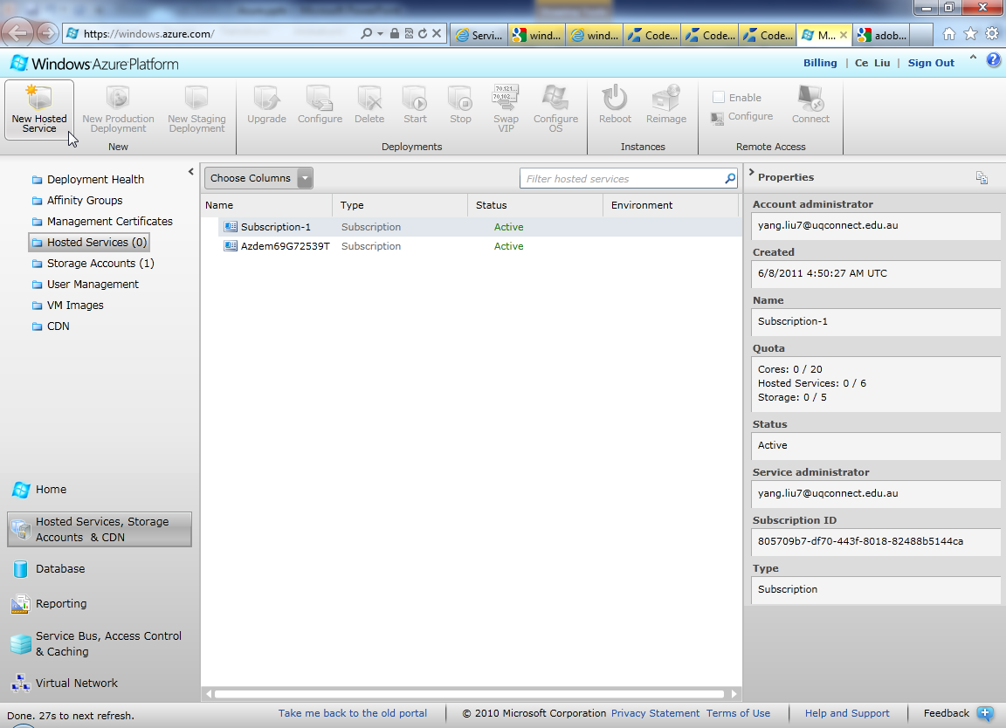
Hosted Services Web page

Slide 21
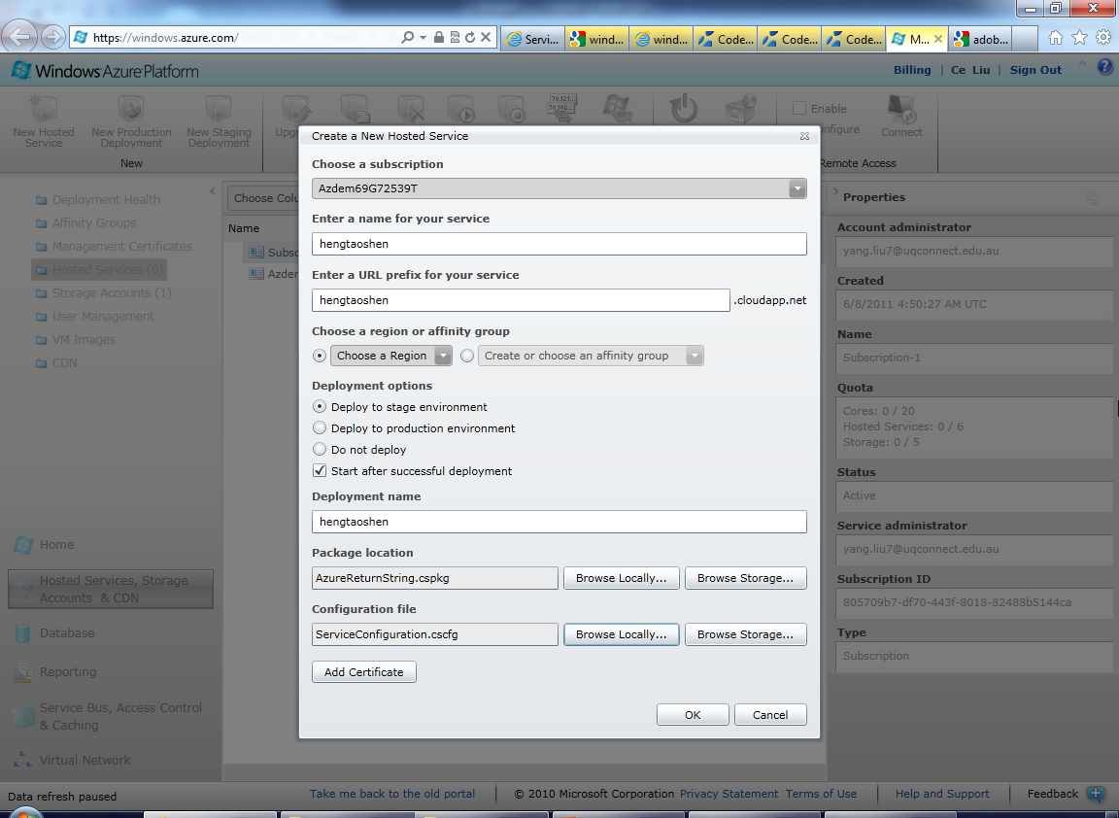
Create a new Hosted Services

Slide 22
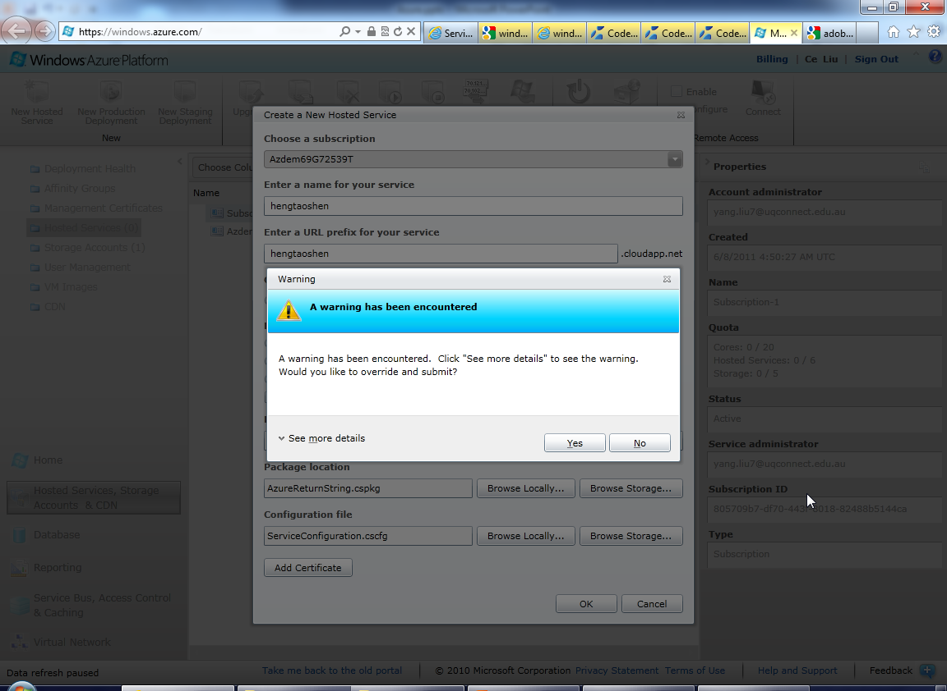
Warning

Slide 23
Practical 7 - Task 1:
Step 8: Create a client to call this service.
1. Back to Windows Studio 2010 and create a Console Application. (File -> New -> Project, on the prompt window, click Visual c# -> console Application).
2. Right click the solution explorer and click Add service reference. On the prompt Window, fill the address like http://d2410dd6115545d7aebd208dbb46bb06.cloudapp.net/service1.svc.
Note: you can find the url on the Windows Azure management page.

Slide 24
Practical 7 - Task 1:
Step 8: Create a client to call this service.
3.For example, http://d2410dd6115545d7aebd208dbb46bb06.cloudapp.net/service1.svc can be navigated in the browser. Click Go and wait for listing services.
4. Select the service1 and click Advanced, to make sure the Always generate message contracts is checked in the Service Reference Settings dialog.

Slide 25
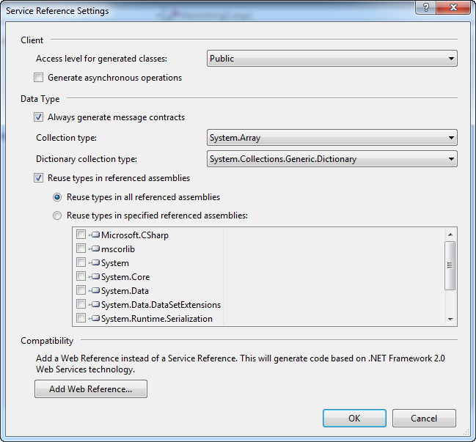
Add Web Services

Slide 26
Practical 7 - Task 1:
Step 9:
Open the program.cs file and modify the code below. click debug menu and Start without Debugging. You will see a prompt windows.

Slide 27
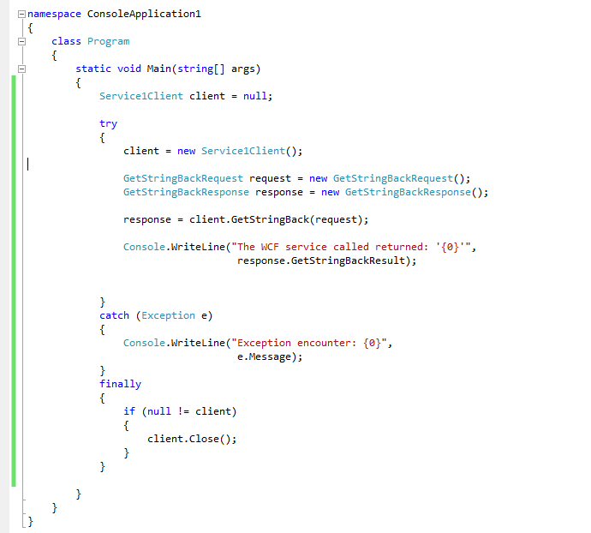
Client side code to call the service

Slide 28
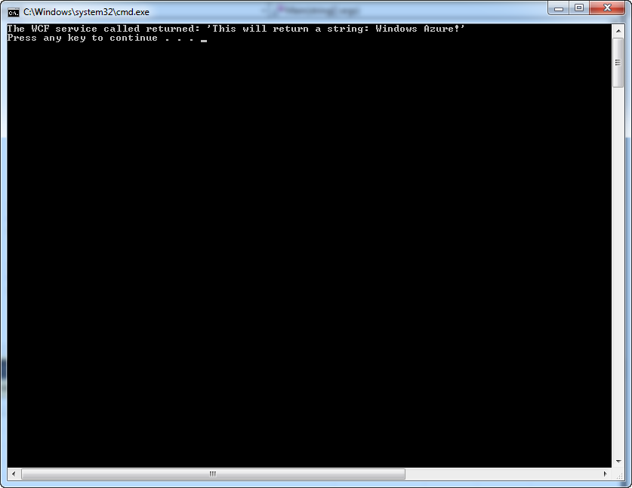
Calling service on the Windows Azure

